Slide 1
TRACEABILITY AND UNCERTAINTY: UTC KEY COMPARISON AND BILATERAL COMPARISON USING THE SIM TIME NETWORK
Time and frequency Workshop
Raul F. Solis B.
CENAMEP AIP

Slide 2
Bureau International des Poids et Mesures
International organization that resides in Paris, France.
Coordinate the international metrology activities like comparisons, the units, the measurement capabilities, etc.
Keeps a database of all comparison, calibration and measurement capabilities and provides worldwide access to the results.

Slide 3
The BIPM Key Comparison Data Base
Containing Appendices A, B, C and D of the CIPM MRA.
Appendix A: Participants in the CIPM MRA.
Appendix B: Key and supplementary comparisons.
Appendix C: Calibration and Measurement Capabilities – CMCs.
Appendix D: List of key comparisons.

Slide 4
UTC: the Only Comparison in Time and Frequency Metrology
The Universal Time Coordinated is our reference value (Key comparison CCTF-K001.UTC, started since 1977 and still ongoing).
The Circular T is the official document that reports the key comparison results.

Slide 5
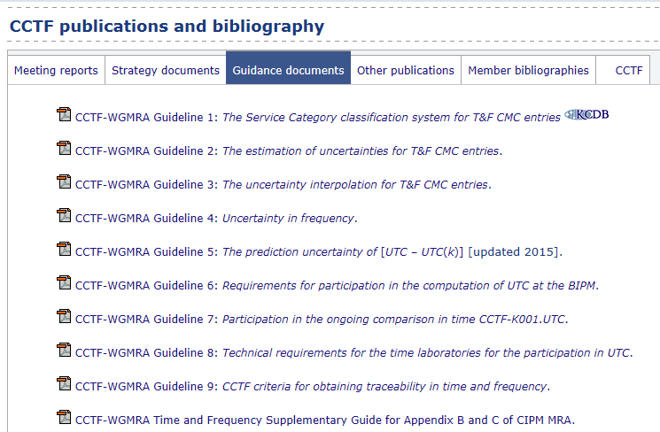
UTC: the Only Comparison in Time and Frequency Metrology

Slide 6
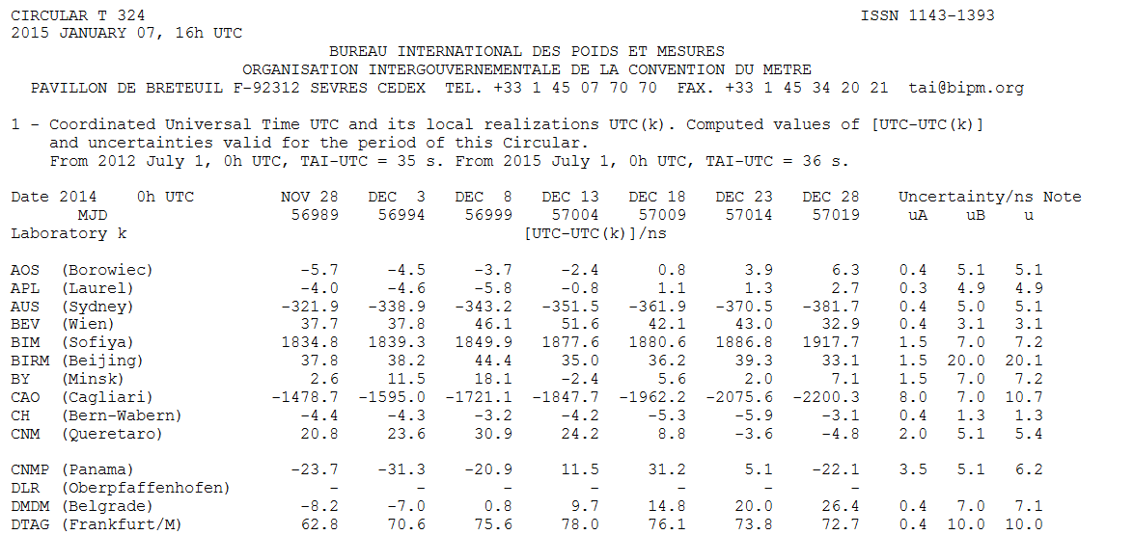
Circular T

Slide 7
Traceability
The property of a measurement result whereby the result can be related to a reference through a documented unbroken chain of calibrations, each contributing to the measurement uncertainty.
“International vocabulary of metrology – Basic and general concepts and associated terms (VIM),” JCGM 200, 3rd edition, p. 29, (2012).

Slide 8
Traceability
Calibration report
Circular T

Slide 9
Circular T
Uncertainty of the
UTC(k) frequency
Uncertainty of the time link
UTC - UTC(k)

Slide 10
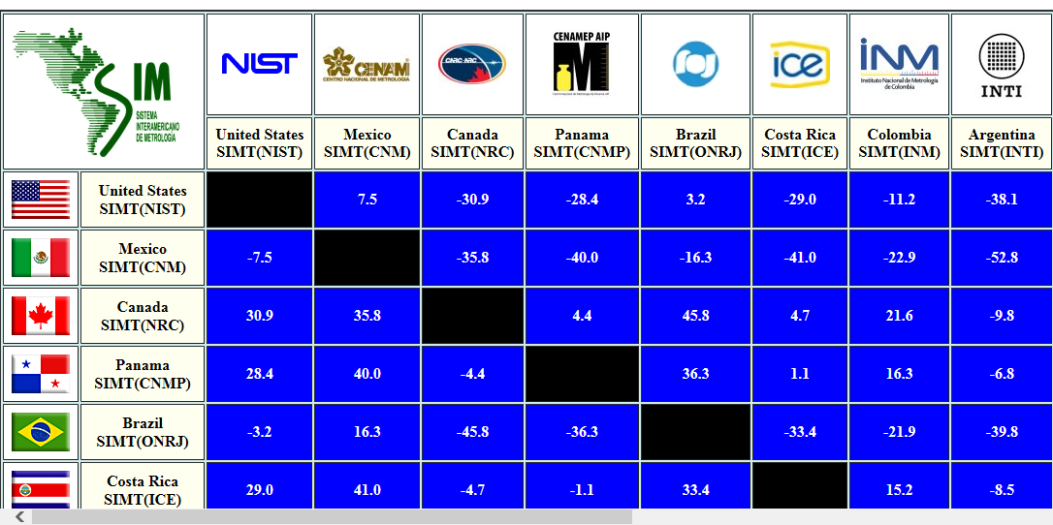
SIM Time Network
Generation
Measurement

Slide 11
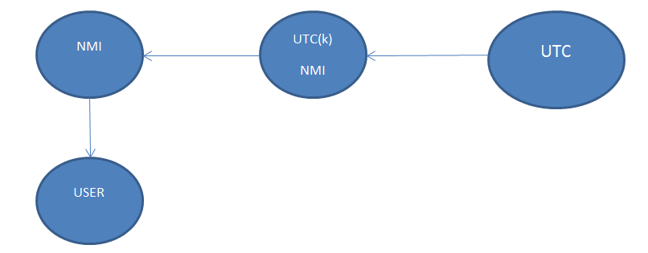
Traceability using the SIMTN
SIMTN
Circular T
Calibration report

Slide 12
SIM Time Network
To claim traceability using the SIM Time Network you need:
A NMI in the SIMTN with UTC(k).
A comparison over 30 days (one Circular T report) to evaluate the performance of your clock.
The NMI choose as source of traceability must have declared CMCs in Remote calibrations (Remote clock vs UTC(k), Remote clock vs UTC or Remote Frequency Standard).
The uncertainty budget of the service.

Slide 13
Thanks rsolis@cenamep.org.pa

